Slide 1
Market basket Analysis
Grocery Store Project
MRA Week 2 Great Learning
Amit Jain
Date:5-Nov-2022

Slide 2
Agenda
Introduction
Exploratory data analysis
Data Descriptive analysis
Univariate Analysis
Time series Analysis
MBA Analysis
What is MBA and association Rule
Support, Confidence and Lift
Workflow Nodes used and Logic
Recommendations
Summary

Slide 3
Introduction
A Grocery Store shared the transactional data with us. Our Job is to identify the most popular combos that can be suggested to the Grocery Store chain after a thorough analysis of the most commonly occurring sets of menu items in the customer orders.
The Store doesn’t have any combo meals as of now and We need to suggest the best combo meals/products that can be sell offered to Customers, with respect to it's Popularity.
We also need to suggest a few things like:
Discount offer, if any we can suggest
Combos, Bye 2 get free kind of offers, etc

Slide 4
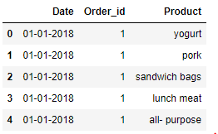
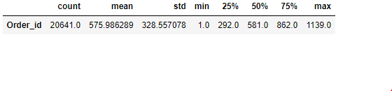
Exploratory data analysis
Data Descriptive analysis
Total No of Sample data 20641
Data Dictionary: Data has 3 fields/columns:
Date : Date of the Transaction
Order_id : Order ID of the Transaction
Product : Product Name for the particular Order made
Number of NULL records in data: 0
Number of Duplicate
records in Sample data : 4730
Which Means there are 4730 products mentioned more than one in same Order, Implicit meaning, possibility of ordered more than one quantity of same Product
Sample of the data set
Data Description :

Slide 5
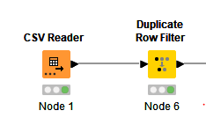
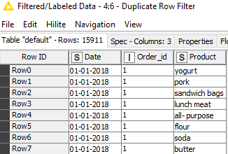
Exploratory data analysis
Univariate Analysis
Number of Duplicate records in Sample data : 4730
Which Means there are 4730 products mentioned more than once in same Order, possibility of ordered more than one quantity of same Product .
After removing duplicate records, total no of unique records in Sample data set are : 15911

Slide 6
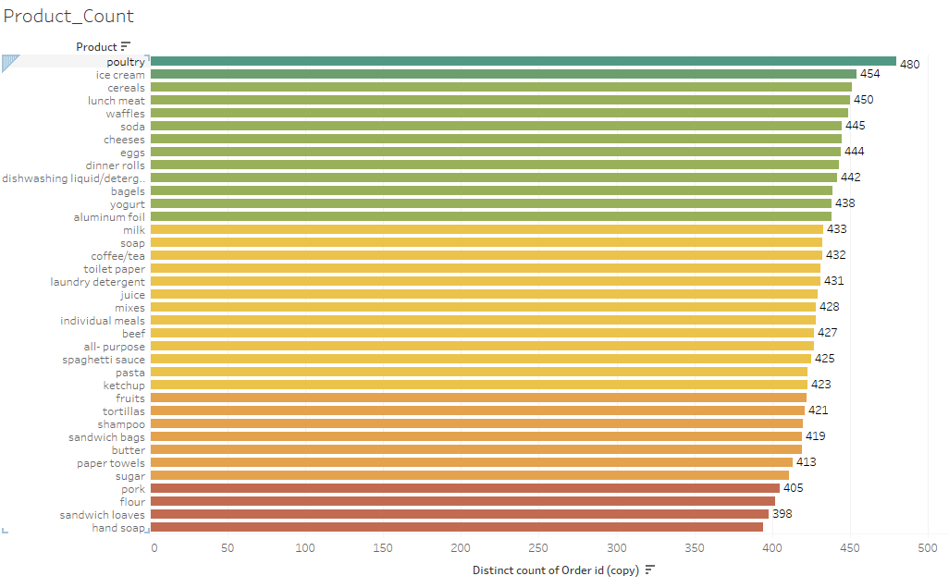
Exploratory data analysis
Univariate Analysis using Tableau
Insights:
Poultry is the most Popular product, which is part of 480 orders , followed by Ice cream having a count of 454.
Least ordered product from the sample record is hand soap with count of 394
If I do not remove duplicate records, then ‘Poultry’ and ‘Soda’ are most popular products , whereas ‘HandSoap’ is remain least ordered Product

Slide 7
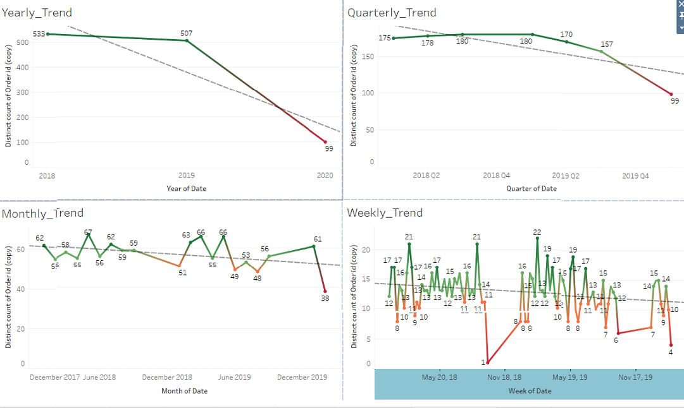
Exploratory data analysis
Timeseries Analysis using Tableau

Slide 8
Exploratory data analysis
Timeseries Analysis using Tableau
Insights:
Sales seems to be slightly declined over the period of time, but there is not much tremendous declined.
We do see trend line going downwards, as time grows.
We also have data missing for Quarter Q4 and year 2018 and 2019, as well as no data points for 10 months for year 2020, in this case we can not say about Overall performance.
Highest Sales according to sample data is still in year 2018
Least Sales is in year 2020, but we do not have Samples for full year of 2020, so we can not say, if it is complete declined. Though January total number of Orders are 61, as compared to 62 , in January 2018 and January 2019, which is not bad

Slide 9
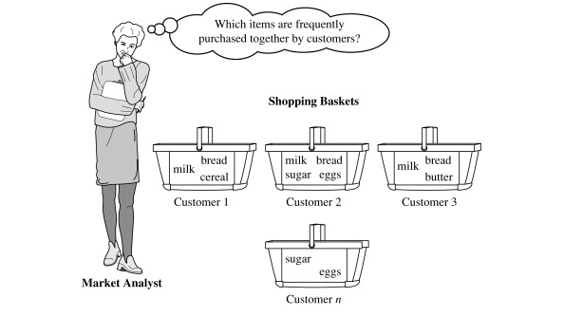
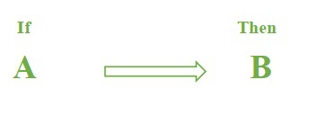
MBA analysis
What is MBA and association Rule
Market Basket Analysis (MBA) is a data mining technique that is used to uncover purchase patterns in any retail setting this is used to analyze the combination of products which been bought together.
MBA identifies the pattern of frequent purchase items by customers. Which can help to promote deals, offers, sale by the companies.
Association Rules
Market basket analysis mainly works with the
ASSOCIATION RULE {IF} -> {THEN}.
IF means Antecedent: An antecedent is an item found within the data
THEN means Consequent: A consequent is an item found in combination
with the antecedent.

Slide 10
MBA analysis
Support, Confidence and Lift
There are three components in majorly used to perform market basket analysis : SUPPORT , CONFIDENCE and LIFT
To understand this, lets take example for our Sample data set from Grocery Store. Eg: 5000 Orders were made now calculate the support, confidence, and lift for the two products, let’s say Milk and Bread out of 5000 orders, 500 orders for Milk, 700 orders for Bread, and 1000 orders for both.
SUPPORT: It is been calculated with the number of Orders divided by the total number of Orders made,
Support = freq(A,B)/N
support(milk) = Orders related to Milk /total transactions i.e support -> 500/5000= 10 percent
CONFIDENCE: It is been calculated for whether the product sales are popular on individual sales or through combined sales. That is calculated with combined transactions/individual transactions.
Confidence = freq(A,B)/freq(A)
Confidence = combine transactions/individual transactions i.e confidence-> 1000/500=20 percent
LIFT: Lift is calculated for knowing the ratio for the sales.
Lift= confidence percent/ support percent
Lift-> 20/10=2
When the Lift value is below 1 means the combination is not so frequently bought by consumers. But in this case, it shows that the probability of buying both the things together is high when compared to the transaction for the individual items sold.

Slide 11
MBA analysis
Choice of support and confidence
The first step in order to create a set of association rules is to determine the optimal thresholds for support and confidence.
If we set these values too low, then the algorithm will take longer to execute and we will get a lot of rules (most of them will not be useful).
We can try different values of support and confidence and see how many rules are generated for each combination.
Let’s analyze the results,
Support level of 10%. We only identified a few rules with very low confidence levels. This means that there are no relatively frequent associations in our data set. We can’t choose this value, the resulting rules are unrepresentative.
Support level of 5%. We only identify a rule with a confidence of at least 50%. It seems that we have to look for support levels below 5% to obtain a greater number of rules with a reasonable confidence.
Support level of 1%. We started to get dozens of rules, of which 13 have a confidence of at least 50%.
Support level of 0.5%. Too many rules to analyze!
To sum up, we are going to use a support level of 1% and a confidence level of 90%.

Slide 12

MBA analysis
KNIME Tool information
KNIME Analytics Platform is the open source software for creating data science projects. Intuitive, open, and continuously integrating new developments. Main features for KNIME are: 1. Open Source 2. No Coding knowledge required, so easy to use 3. Data science technique knowledge is required, to decide which technique to implement. 4. Node based implementations. 5. Check data in every Node, which makes easy to debug. 6. Developers can write any kind of Node, they want and embed it with KNIME easily. 6. Export, Import, Share, Enjoy.

Slide 13
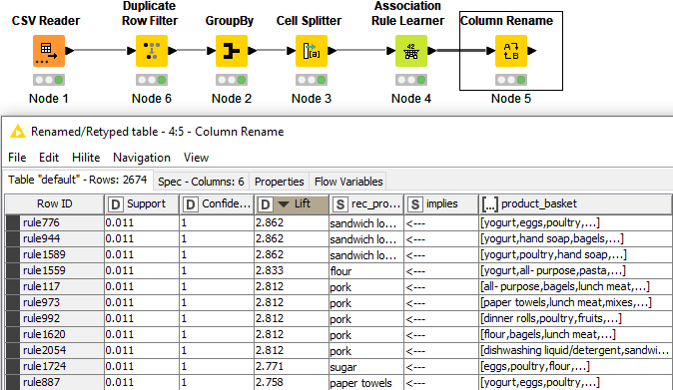
MBA analysis
KNIME Workflow

Slide 14
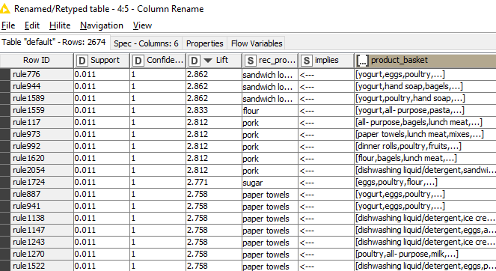
MBA analysis
KNIME Workflow
Insights :
This is the results of recommended products along with basket items List.
We have sorted output based on Lift and Highest Lift means; Best recommendations based on associated rules.

Slide 15
MBA analysis
Recommended items List
Support | Confidence | Lift | Recommendations | basket Product List
0.01053556 | 1 | 2.86180905 | sandwich loaves | [yogurt, eggs, poultry, fruits, lunch meat, sandwich bags]
0.01053556 | 1 | 2.86180905 | sandwich loaves | [yogurt, hand soap, bagels, cereals, coffee/tea, juice]
0.01141352 | 1 | 2.86180905 | sandwich loaves | [yogurt, poultry, hand soap, aluminum foil, soap]
0.01141352 | 1 | 2.83333333 | flour | [yogurt, all- purpose, pasta, individual meals, coffee/tea]
0.01053556 | 1 | 2.81234568 | pork | [all- purpose, bagels, lunch meat, aluminum foil, ketchup]
0.01053556 | 1 | 2.81234568 | pork | [paper towels, lunch meat, mixes, coffee/tea, soap, ketchup]
0.01053556 | 1 | 2.81234568 | pork | [dinner rolls, poultry, fruits, all- purpose, aluminum foil, soap]
0.01141352 | 1 | 2.81234568 | pork | [flour, bagels, lunch meat, aluminum foil, ketchup]
0.01141352 | 1 | 2.81234568 | pork | [dishwashing liquid/detergent, sandwich loaves, milk, soda, soap, ketchup]
0.01141352 | 1 | 2.77128954 | sugar | [eggs, poultry, flour, lunch meat, soap]
0.01053556 | 1 | 2.75786925 | paper towels | [yogurt, eggs, poultry, pasta, coffee/tea, soda]
0.01053556 | 1 | 2.75786925 | paper towels | [yogurt, eggs, poultry, ice cream, pasta, coffee/tea]
0.01053556 | 1 | 2.75786925 | paper towels | [dishwashing liquid/detergent, ice cream, fruits, all- purpose, lunch meat, aluminum foil]
0.01053556 | 1 | 2.75786925 | paper towels | [dishwashing liquid/detergent, eggs, all- purpose, pasta, milk, lunch meat]
0.01053556 | 1 | 2.75786925 | paper towels | [dishwashing liquid/detergent, ice cream, fruits, pasta, milk, lunch meat]
0.01053556 | 1 | 2.75786925 | paper towels | [poultry, all- purpose, milk, mixes, aluminum foil, soap]
0.01053556 | 1 | 2.75786925 | paper towels | [dishwashing liquid/detergent, eggs, poultry, milk, laundry detergent, juice]
0.01229148 | 1 | 2.75786925 | paper towels | [eggs, spaghetti sauce, poultry, pasta, sandwich bags]
Insights :
This is the snapshot from KNIME workflow output, we have sorted results for Highest Lift first.

Slide 16
Recommendations
KNIME Workflow
The Grocery store can recommend “sandwich loaves”, if Customers have these items in the cart List :
[yogurt, eggs, poultry, fruits, lunch meat, sandwich bags]
[yogurt, hand soap, bagels, cereals, coffee/tea, juice]
[yogurt, poultry, hand soap, aluminum foil, soap]
Or they can give Combo offer for this combinations , as it has a very good Lift value as compared to other items.
Store can give suggestions of buying “Pork” or run any offer to recommend “Pork”, if Customer have these items in their shipping cart:
[all- purpose, bagels, lunch meat, aluminum foil, ketchup]
[paper towels, lunch meat, mixes, coffee/tea, soap, ketchup]
[dinner rolls, poultry, fruits, all- purpose, aluminum foil, soap]
[flour, bagels, lunch meat, aluminum foil, ketchup]
[dishwashing liquid/detergent, sandwich loaves, milk, soda, soap, ketchup]
Customers can be offered Some Combo package or good discounts on “Paper towels”, as it is highly recommended product, in case customer have these items in their shopping cart:
[yogurt, eggs, poultry, pasta, coffee/tea, soda]
[dishwashing liquid/detergent, ice cream, fruits, all- purpose, lunch meat, aluminum foil]
[dishwashing liquid/detergent, eggs, all- purpose, pasta, milk, lunch meat]
[dishwashing liquid/detergent, eggs, poultry, milk, laundry detergent, juice]
[poultry, all- purpose, milk, mixes, aluminum foil, soap]
[eggs, spaghetti sauce, poultry, pasta, sandwich bags]

Slide 17
Conclusions
I have done Market basket analysis , based on the Sample Orders, and Products of those Orders and this Sample data is limited to 2 years worth of data.
Data is not complete; we have missing data elements for couple of months each year.
Data does not have price and profit for each Product or each transactions
Discounts can be offered, based on in total price of all the products, or Combo offer can be made based on price and profit of the combinations.
Discount decision can be made , if we have given price and profits of each individual products as well.
Further analysis is required for complete market basket analysis.
This workflow can give only recommendations or suggested products with the other Items in Customer’s Cart

Slide 18
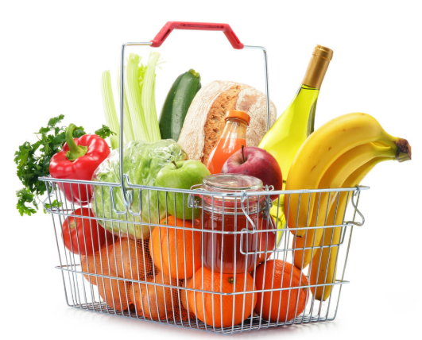
Thank You Amit Jain 5-Nov-2022

